Slide 1
COMP 4290
Week 1 - Wednesday

Slide 2
Last time
What did we talk about last time?
Course overview
Terminology
  Threats
  Vulnerabilities
  Attacks
  Controls
CIA

Slide 3
Questions?

Slide 4
Sign up for Presentations

Slide 5
Form Teams for Project 1

Slide 6
Security tidbit: LLMs can import malicious code
Many people are using LLMs to help them code
But new "agentic" tools can pull information from various sources, like GitHub issue pages
If attackers can sneak malicious code into those sources, that code can be pulled into your program
  Techniques called "ASCII smuggling" put invisible characters into messages that LLMs can read even if humans can't see them
Once your code runs, either for testing purposes or in a product, the malicious code can do whatever it wants on the target system
These risks are even greater with inexperienced coders and vibe coding
Credit to Professor Stucki for letting me know about the research
Read more:
  https://garymarcus.substack.com/p/llms-coding-agents-security-nightmare

Slide 7
CIA
Confidentiality
Integrity
Availability

Slide 8
Encryption
Encryption is the scrambling of data
  Often a key or some other secret information is used to do the scrambling
  Without knowledge of the secret, the data becomes useless
Modern encryption is one of the most powerful tools for preserving computer security
Most modern attacks do not depend on breaking encryption but on circumventing it

Slide 9
Encryption
The process of encryption takes plaintext as an input and produces ciphertext as an output
Plaintext (or cleartext) is not necessarily human readable, but its contents are not protected in any way
Using cryptography, we can build protocols to support confidentiality and integrity (and even availability indirectly)
As useful as it is, encryption is not a panacea

Slide 10
Attackers

Slide 11
Individuals
Most computer criminals are amateurs
  They commit crimes of opportunity
  Time-stealing is common
Disgruntled or recently fired employees can use their knowledge of a system to attack it
Many hackers attempt to gain access to other people's computer systems for the fun or challenge of it
  They often brag about their exploits

Slide 12
Organized crime
Most professional hackers are trained computer scientists who have turned to crime
In the early days of hacking and viruses, destroying hardware, software, or data was the goal
Professional hackers now look to make money by stealing valuable data
There are connections to organized crime
Many attacks come from Russia, Asia, and Brazil
Professionals want to remain undetected so that they can keep stealing data
Ransomware is big business:
  Purplesec reports an average cost of over $5 million per attack
  The FBI reported losses of over $16 billion in 2023 for Internet crime

Slide 13
Terrorists
Modern terrorists are often computer savvy
Four common forms of terrorist computer usage are:
  Targets of attacks
    Denial-of-service and defacement of websites
  Methods of attack
    Using computers to launch an attack
  Enablers of attacks
    Coordinating or initiating other forms of terrorism through websites, e-mail, etc.
  Enhancers of attacks
    Using the Internet to spread propaganda and recruit agents

Slide 14
Harm and risk
Harm is the bad thing that happens when the threat occurs
Risk management is about choosing which threats to control and which not to
  Remember that this is usually a financial decision
Residual risk is the risk that is still not controlled after risk management

Slide 15

Risk perception
What's the chance that a huge meteor will hit during our lifetimes?
  Small!
  Likelihood is the chance that a threat will happen
What will happen if a huge meteor hits?
  Terrible things!
  Impact is the damage of a threat
Humans overestimate the likelihood of rare, dreaded events

Slide 16
Method, opportunity, motive
As with traditional crime, a computer attacker must have three things:
Method
Skills and tools to perform the attack
Opportunity
Time and access to accomplish the attack
Motive
A reason to perform the attack

Slide 17
Controls

Slide 18
Controls
There are six common ways of controlling attacks, many of which can be used together
Prevent
Remove the vulnerability from the system
Deter
Make the attack harder to execute
Deflect
Make another target more attractive (perhaps a decoy)
Detect
Discover that the attack happened, immediately or later
Recover
Recover from the effects of the attack
Mitigate
Make the effect of the attack less severe

Slide 19
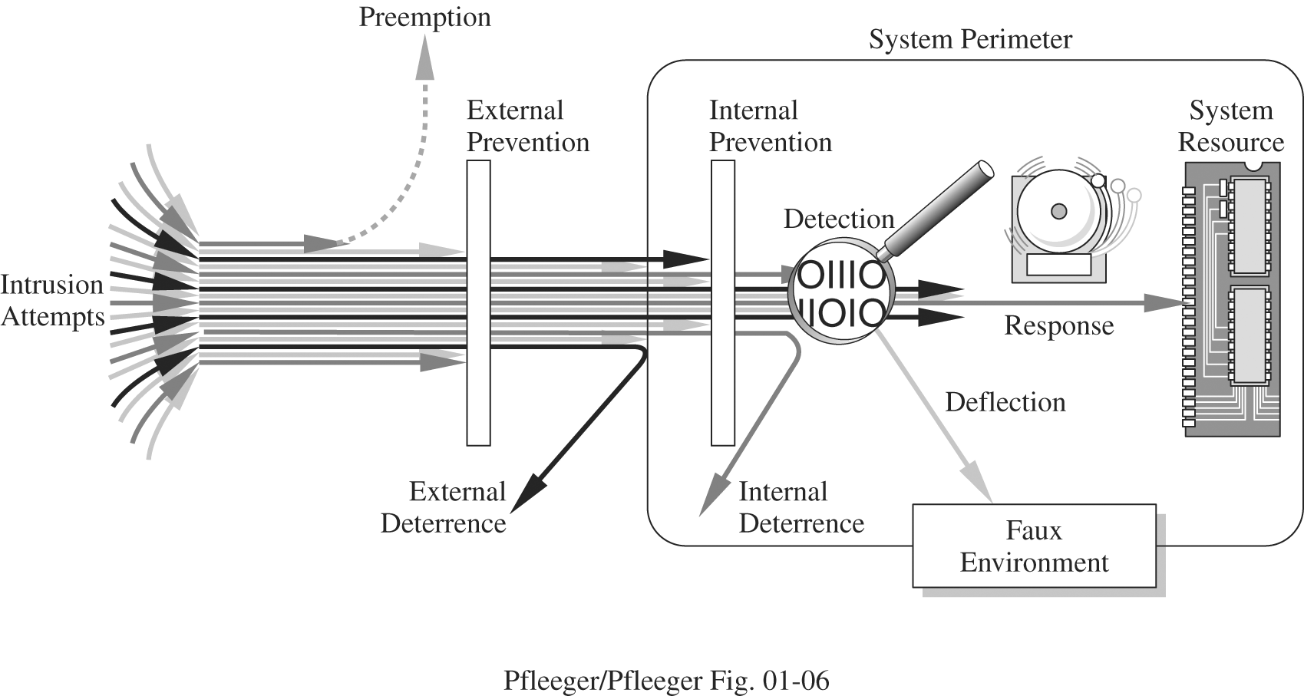
Effects of controls
Many different controls can be used to achieve the six methods of defense

Slide 20
Physical controls
Physical controls can be inexpensive and effective
  Locks on doors
  Security guards
  Backup copies of data
  Planning for natural disasters and fires
Simple controls are often the best
Attackers will always look for a weak point in your defenses

Slide 21
Procedural controls
Human beings ultimately get involved
It's important to have policies and procedures to guide their actions, such as:
  Change passwords regularly
  Don't give people your password
  Don't allow coworkers access to data they should not have
Laws are important policies with consequences, but they react slowly to the rapid changes in technology

Slide 22
Technical controls
Software controls:
  Passwords
  OS and network controls
    Tools to protect users from each other
  Independent control programs
    Application programs that protect against specific vulnerabilities
  Development controls
    Quality control for creating software so that vulnerabilities are not introduced
Hardware controls
  Smart cards on satellite or cable television set-top boxes
  Fingerprint or other biometric readers
  Firewalls

Slide 23
Effectiveness of controls
Many issues impact the effectiveness of controls
  Awareness of problem
    Users must be convinced that it is worth using the controls
  Likelihood of use
    The controls must be easy enough to use that the task performed is not seriously affected
  Overlapping controls
    Overlapping controls or defense in depth can help, but sometimes the controls negatively impact each other
  Periodic review
    Conditions change, and controls must be reviewed periodically and updated when needed

Slide 24
Counting

Slide 25
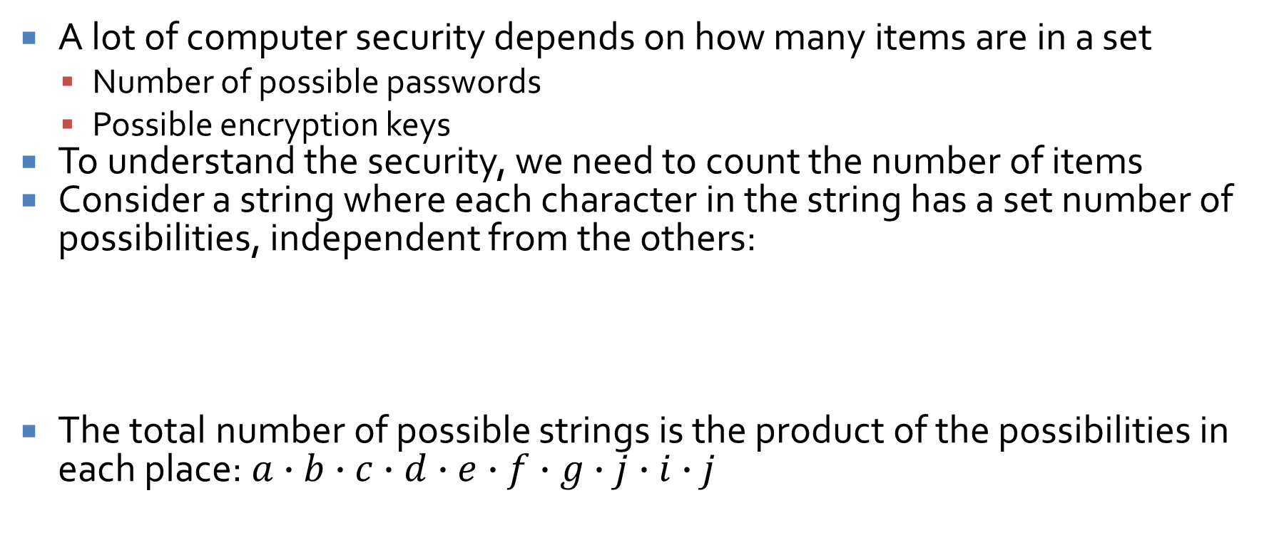
Counting
A lot of computer security depends on how many items are in a set
  Number of possible passwords
  Possible encryption keys
To understand the security, we need to count the number of items
Consider a string where each character in the string has a set number of possibilities, independent from the others:
The total number of possible strings is the product of the possibilities in each place: $a∙b∙c∙d∙e∙f∙g∙j∙i∙j$
Place | ___ | ___ | ___ | ___ | ___ | ___ | ___ | ___ | ___ | ___
Possibilities | a | b | c | d | e | f | g | h | i | j

Slide 26
Counting practice
How many passwords are there of exactly length 8, containing only letters and digits?
How many passwords are there with lengths between 4 and 8, containing only letters and digits?
How many 128-bit AES keys exist?
How many 10-byte sequences are possible?

Slide 27
Upcoming

Slide 28
Next time…
Authentication
Passwords
Biometrics

Slide 29
Reminders
Read Section 2.1
Start Assignment 1
Start Project 1

